Slide 1

Customer Shopping Behavior Analysis
3,900 transactions · 18 features · Python · SQL · Power BI

Slide 2

Dataset at a Glance
3,900
Rows
Transactional records
18
Columns
Features per record
37
Missing Values
Review Rating only
4
Categories
Clothing, Accessories, Footwear, Outerwear

Slide 3


Key Features
Demographics
Purchase Details
Shopping Behavior
Age, Gender, Location, Subscription Status
Item, Category, Amount, Season, Size, Color
Discount, Frequency, Review Rating, Shipping Type

Slide 4

Data Preparation in Python
Load & Explore
Clean
Engineer Features
Load to MySQL
Columns standardized to snake_case; promo_code_used dropped as redundant with discount_applied.

Slide 5
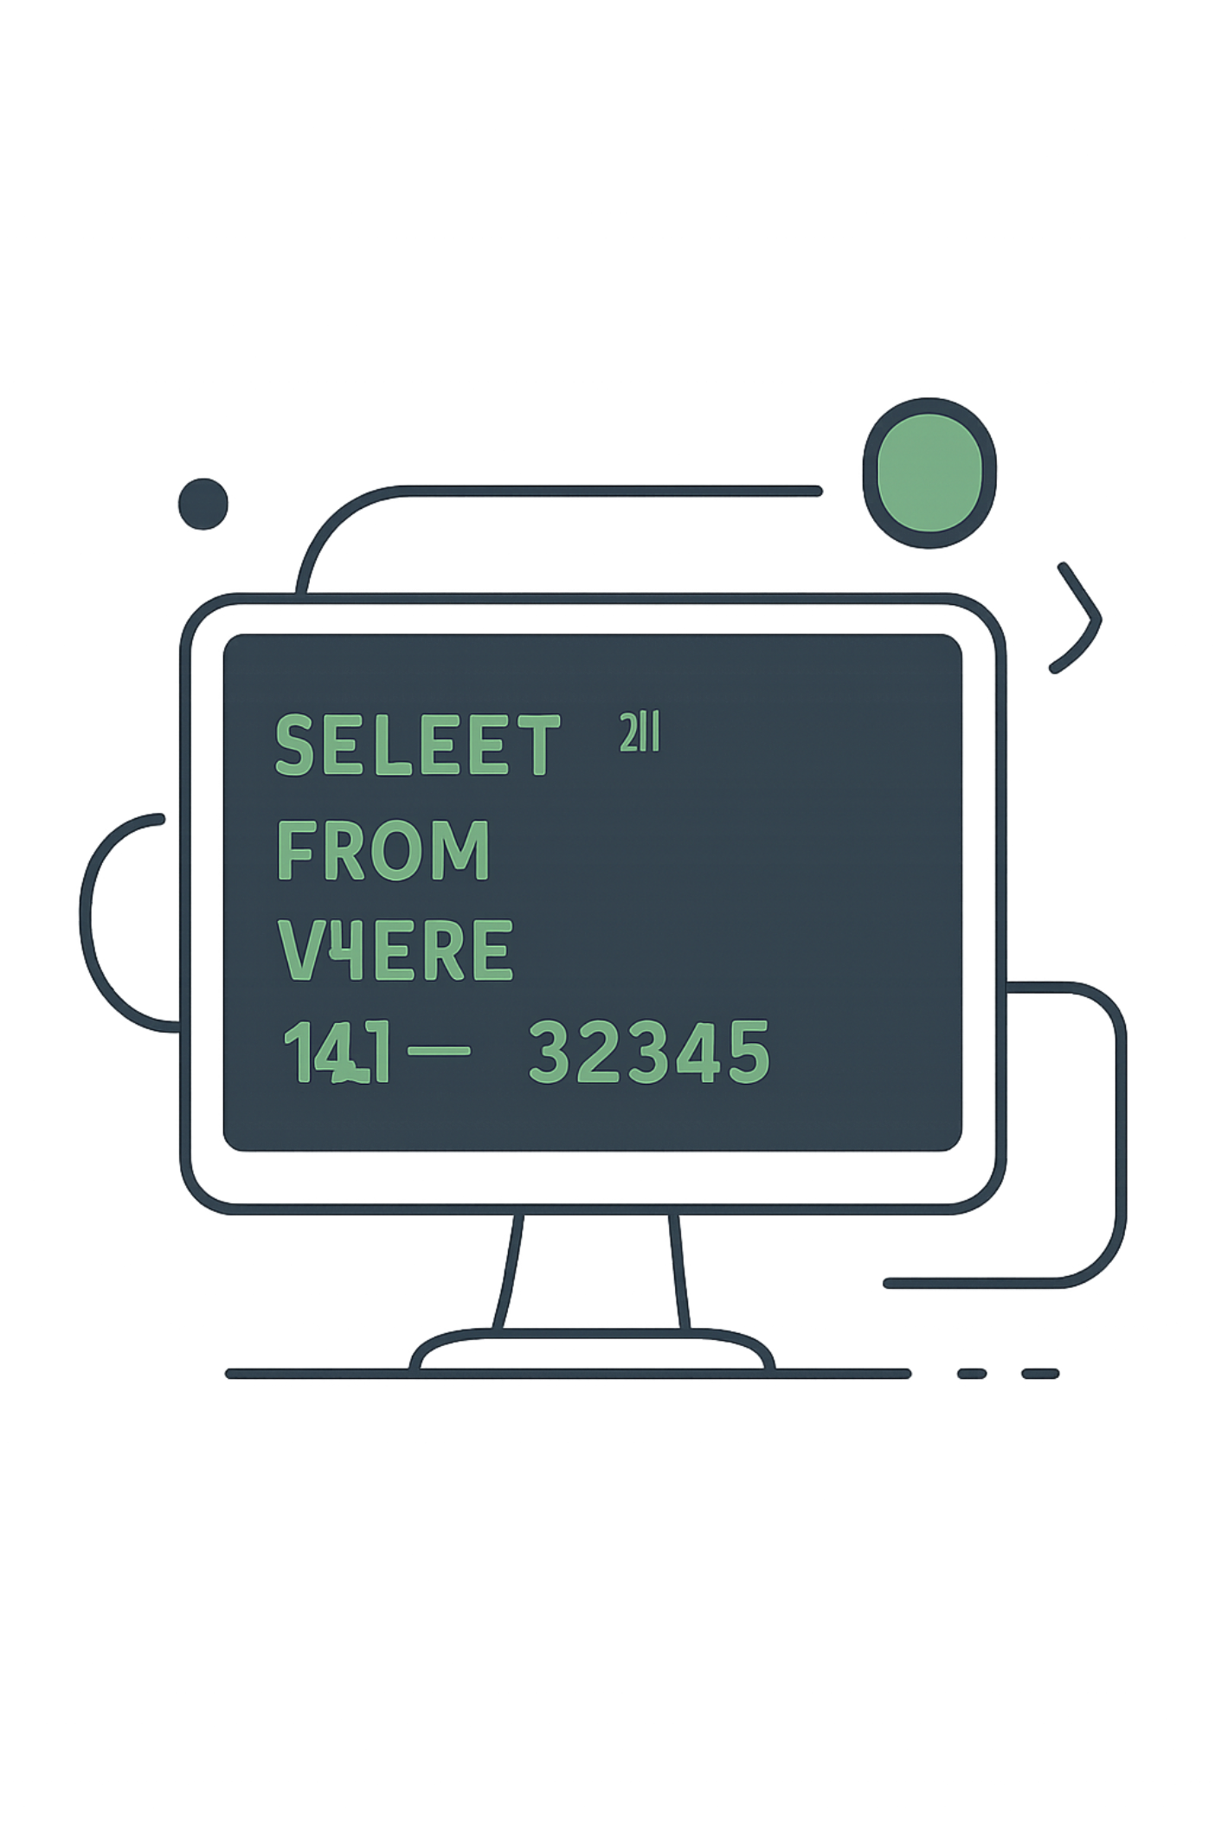
SQL Analysis: 10 Business Questions
Revenue
By gender & age group
Discounts
High-spend discount users & discount-dependent products
Products
Top 5 by rating · Top 3 per category
Shipping
Standard vs. Express spend comparison

Slide 6
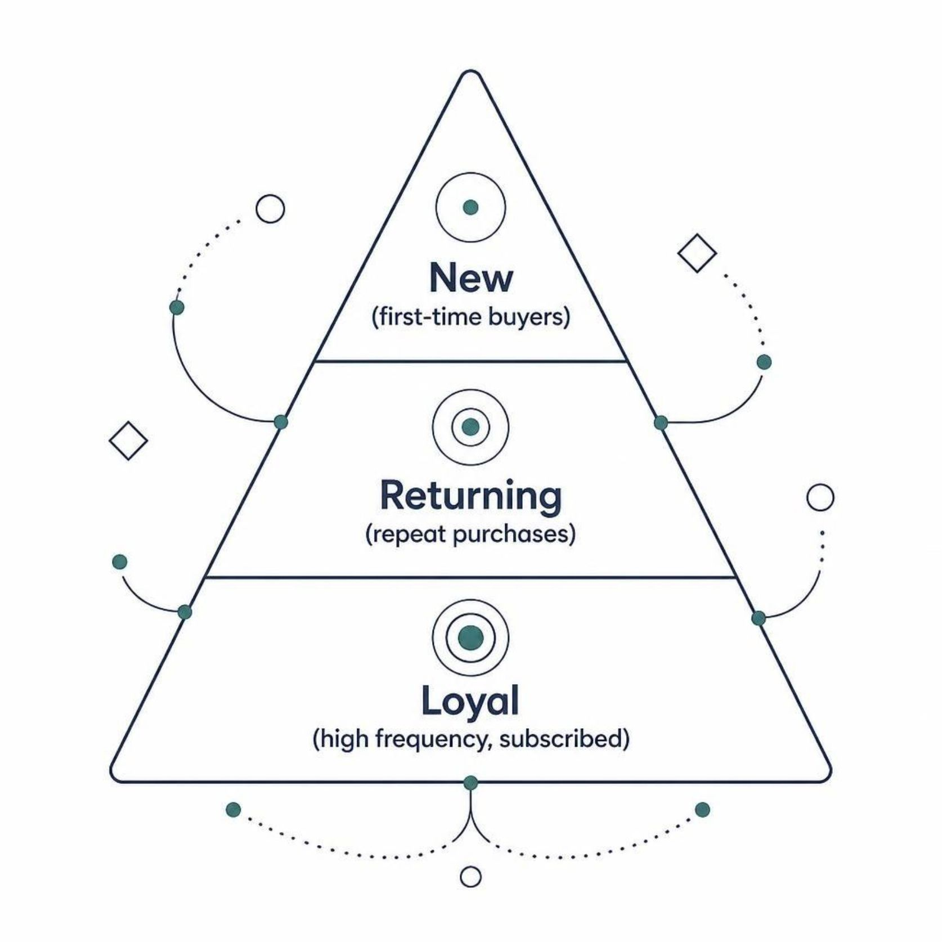
SQL Analysis: Customer Segmentation
Segmentation Logic
Customers classified by purchase frequency and subscription status.
Repeat buyers with >5 purchases more likely to subscribe
Subscribers compared vs. non-subscribers on avg spend & revenue

Slide 7




Power BI Dashboard
Revenue by Category
Subscriptions
Clothing $104K · Accessories $74K · Footwear $36K · Outerwear $19K
73% No · 27% Yes
Payment Methods
PayPal, Credit Card, Cash, Debit, Gift Card, Bank Transfer — evenly distributed (~16–17% each)

Slide 8
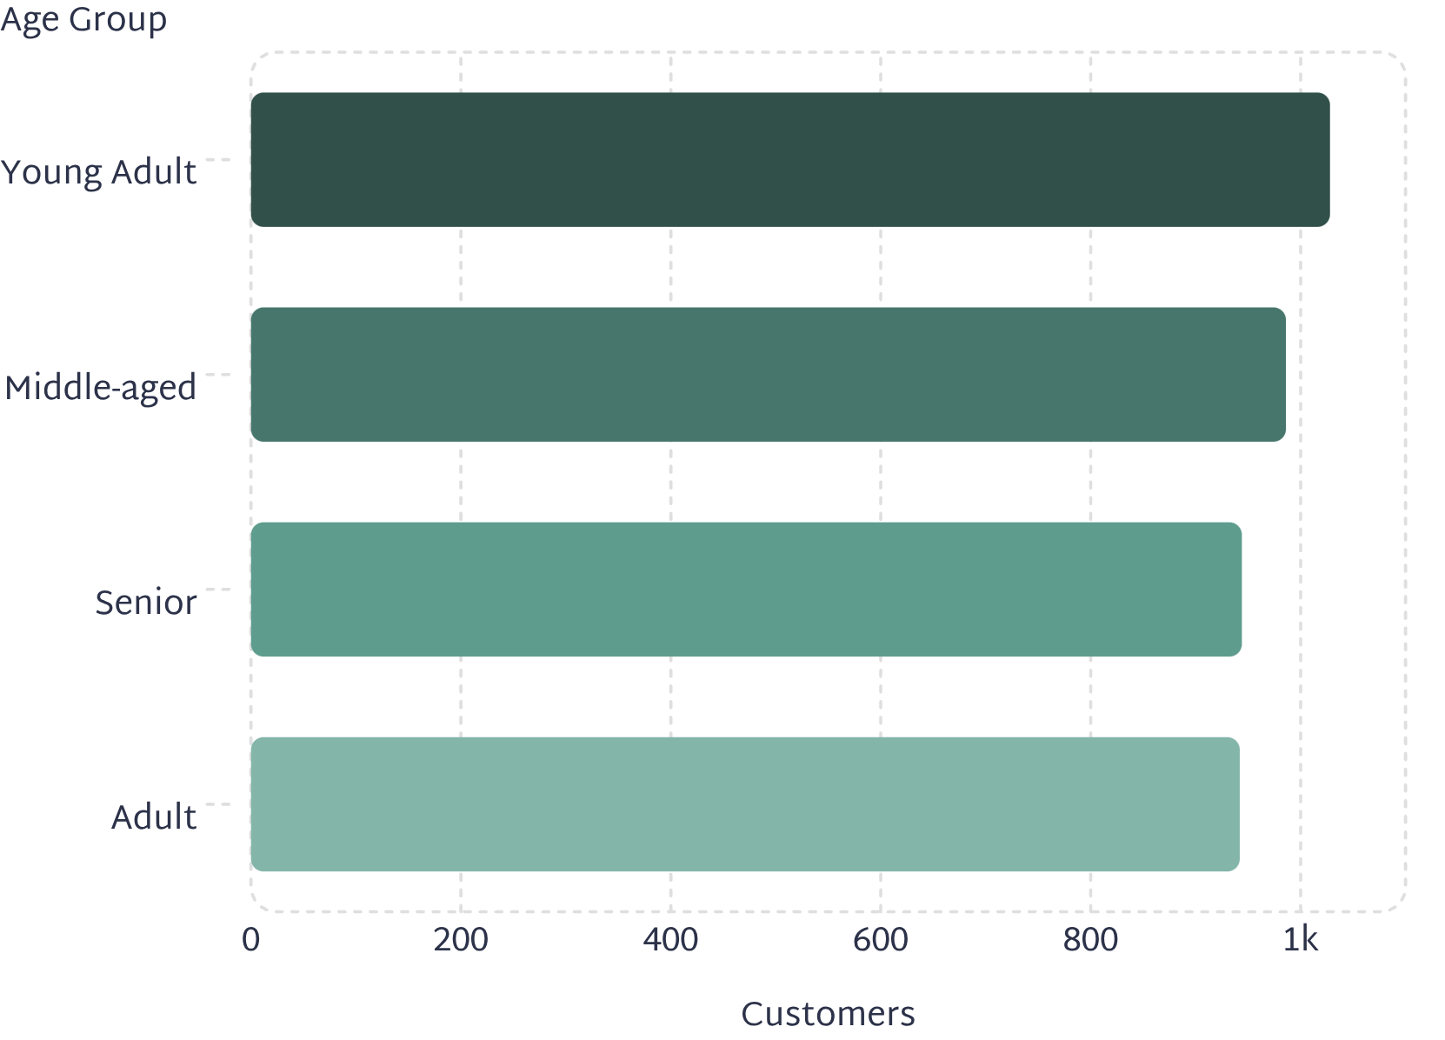
Dashboard Key Metrics
3.90K
89
3.75
Total Customers
Avg Purchase Frequency
Avg Review Rating
Days between purchases
Customer Distribution by Age Group
Young Adults lead with 1,028 customers; distribution is relatively balanced across all four age groups.

Slide 9
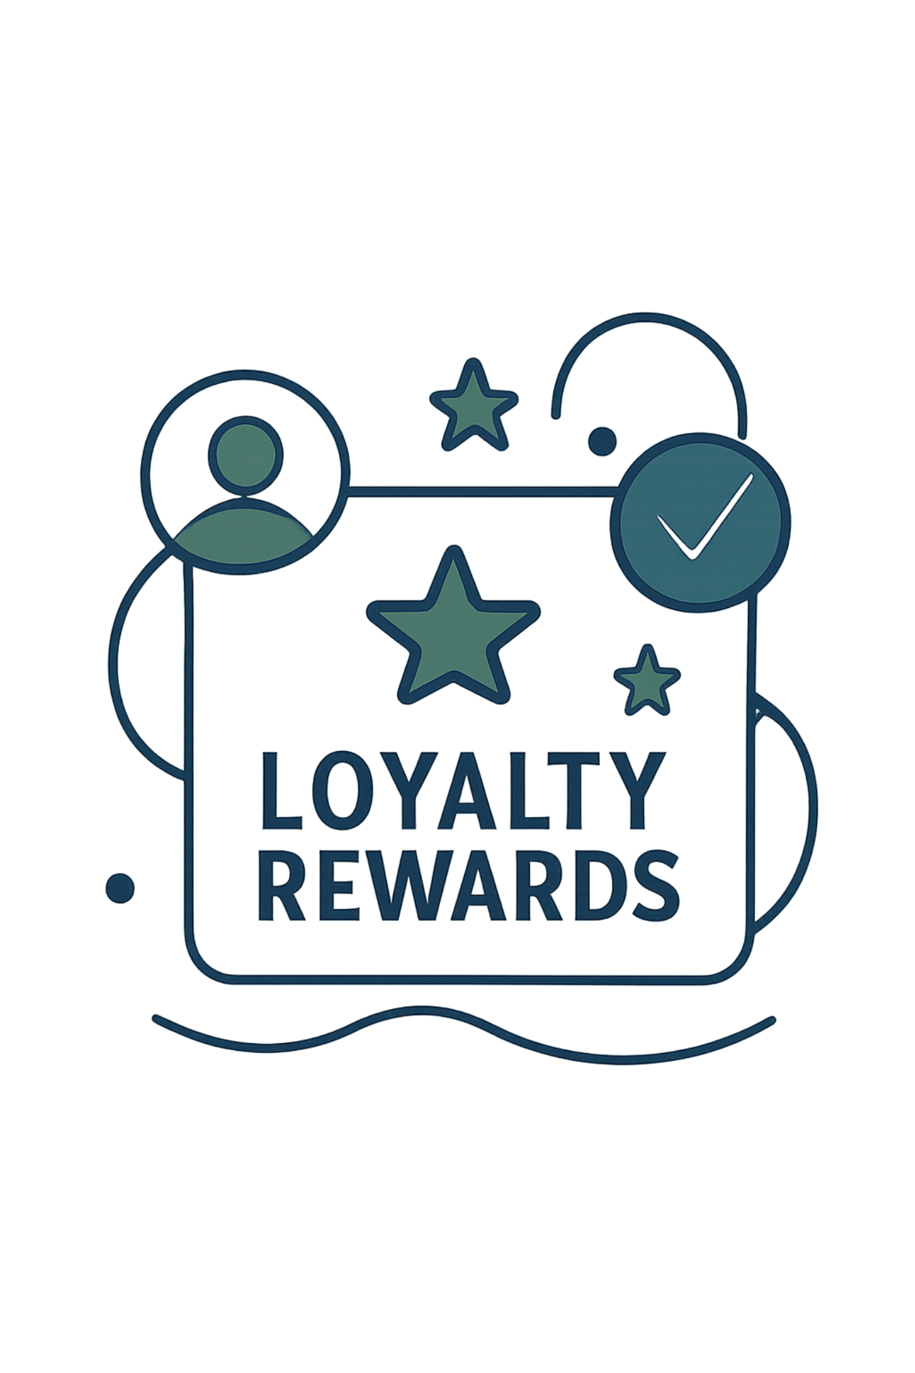

Key Findings
Payment Preference in clothing & accessories
Adults & young adults prefer debit/credit cards 18–20% more than older groups
Subscription Dependency
All subscribers fully depend on discounts — review margins
Purchase Frequency
Clothing & accessories avg 90 days — target 80–85 days

Slide 10
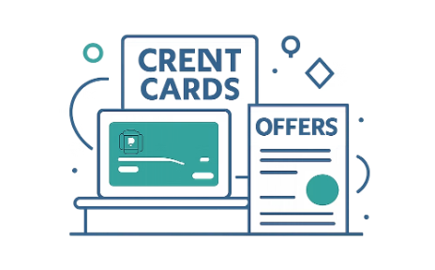

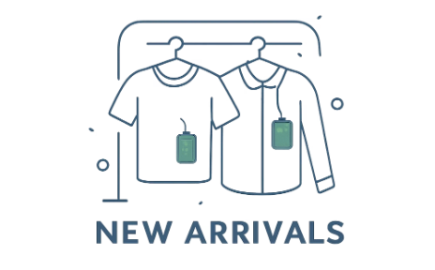
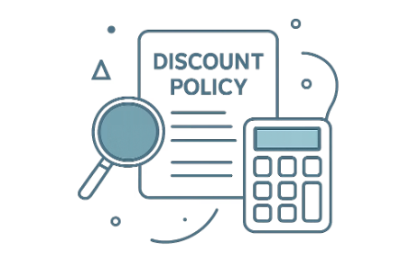
Recommendations
Card-Based Marketing
Loyalty Programs
Promote New Arrivals
Review Discount Policy
Target young adults & adults with credit/debit card offers
Reward repeat buyers & subscribers to grow "Loyal" segment
Launch campaigns every 6–8 weeks to hit 80–85 day frequency target
Audit subscriber discount margins — 100% dependency risk

